Slide 1
Part 1.0: Intelligent Agents
Intelligent Agents (IA) - Concept
IA Types
Environment types
IA Behaviour
IA Structure

Slide 2
Mission
To design/create computer programs that have some intelligence/ can do some intelligent tasks/ or can do tasks that require some intelligence.

Slide 3
What is an (Intelligent) Agent?
An over-used, over-loaded, and misused term.
Anything that can be viewed as perceiving its environment through sensors and acting upon that environment through its effectors to maximize progress towards its goals.
PAGE (Percepts, Actions, Goals, Environment)
Task-specific & specialized: well-defined goals and environment
The notion of an agent is meant to be a tool for analyzing systems, not an absolute characterization that divides the world into agents and non-agents. Much like, e.g., object-oriented vs. imperative program design approaches.

Slide 4
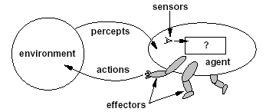
Intelligent Agents
Agents interact with environments through sensors and effectors

Slide 5

Intelligent Agents and Artificial Intelligence
Human mind as network of thousands or millions of agents all working in parallel. To produce real artificial intelligence, this school holds, we should build computer systems that also contain many agents and systems for arbitrating among the agents' competing results.
Distributed decision-making
and control
Challenges:
  Action selection: What next action
  to choose
  Conflict resolution
Agency
sensors
effectors

Slide 6
Agent Research Areas
We can split agent research into two main strands:
Distributed Artificial Intelligence (DAI) –
Multi-Agent Systems (MAS) (1980 – 1990)
Much broader notion of "agent" (1990’s – present)
  interface, reactive, mobile, information

Slide 7
PEAS
PEAS: Performance measure, Environment, Actuators, Sensors
Must first specify the setting for intelligent agent design
Consider, e.g., the task of designing an automated taxi driver:
  Performance measure
  Environment
  Actuators
  Sensors

Slide 8
PEAS
Must first specify the setting for intelligent agent design
Consider, e.g., the task of designing an automated taxi driver:
  Performance measure: Safe, fast, legal, comfortable trip, maximize profits
  Environment: Roads, other traffic, pedestrians, customers
  Actuators: Steering wheel, accelerator, brake, signal, horn
  Sensors: Cameras, sonar, speedometer, GPS, odometer, engine sensors, keyboard

Slide 9
PEAS
Agent: Medical diagnosis system
Performance measure: Healthy patient, minimize costs, lawsuits
Environment: Patient, hospital, staff
Actuators: Screen display (questions, tests, diagnoses, treatments, referrals)
Sensors: Keyboard (entry of symptoms, findings, patient's answers)

Slide 10
PEAS
Agent: Part-picking robot
Performance measure: Percentage of parts in correct bins
Environment: Conveyor belt with parts, bins
Actuators: Jointed arm and hand
Sensors: Camera, joint angle sensors

Slide 11
PEAS
Agent: Interactive English tutor
Performance measure: Maximize student's score on test
Environment: Set of students
Actuators: Screen display (exercises, suggestions, corrections)
Sensors: Keyboard

Slide 12
A Windscreen Agent
How do we design a agent that can wipe the windscreens when needed?
Goals?
Percepts ?
Sensors?
Effectors ?
Actions ?
Environment ?

Slide 13
A Windshield Wiper Agent (Cont’d)
Goals: To keep windscreens clean and maintain good visibility
Percepts: Raining, Dirty, Clear
Sensors: Camera (moist sensor)
Effectors: Wipers (left, right, back)
Actions: Off, Slow, Medium, Fast
Environment: Nairobi city, pot-holed roads, highways, bundus, weather …

Slide 14

Towards Autonomous Vehicles

Slide 15
Interacting Agents
Collision Avoidance Agent (CAA)
Goals: Avoid running into obstacles
Percepts ?
Sensors?
Effectors ?
Actions ?
Environment: Highway
Lane Keeping Agent (LKA)
Goals: Stay in current lane
Percepts ?
Sensors?
Effectors ?
Actions ?
Environment: Freeway

Slide 16
Interacting Agents
Collision Avoidance Agent (CAA)
Goals: Avoid running into obstacles
Percepts: Obstacle distance, velocity, trajectory
Sensors: Vision, proximity sensing
Effectors: Steering Wheel, Accelerator, Brakes, Horn, Headlights
Actions: Steer, speed up, brake, blow horn, signal (headlights)
Environment: Highway
Lane Keeping Agent (LKA)
Goals: Stay in current lane
Percepts: Lane center, lane boundaries
Sensors: Vision
Effectors: Steering Wheel, Accelerator, Brakes
Actions: Steer, speed up, brake
Environment: Freeway

Slide 17
The Right Thing = The Rational Action
Rational Action: The action that maximizes the expected value of the performance measure given the percept sequence to date
  Rational = Best ?
  Rational = Optimal ?
  Rational = Omniscience ?
  Rational = Successful ?

Slide 18
The Right Thing = The Rational Action
Rational Action: The action that maximizes the expected value of the performance measure given the percept sequence to date
  Rational = Best Yes, to the best of its knowledge
  Rational = Optimal Yes, to the best of its abilities (incl. its constraints)
  Rational ≠ Omniscience
  Rational ≠ Successful

Slide 19
Behavior and performance of IAs
Perception (sequence) to Action Mapping: f : P* → A
  Ideal mapping: specifies which actions an agent ought to take at any point in time
  Description: Look-Up-Table,..
Performance measure: a subjective measure to characterize how successful an agent is (e.g., speed, power usage, accuracy, money, etc.)
(degree of) Autonomy: to what extent is the agent able to make decisions and actions on its own?

Slide 20
How is an Agent different from other software?
Agents are autonomous, that is they act on behalf of the user
Agents contain some level of intelligence, from fixed rules to learning engines that allow them to adapt to changes in the environment
Agents don't only act reactively, but sometimes also proactively
Agents have social ability, that is they communicate with the user, the system, and other agents as required
Agents may also cooperate with other agents to carry out more complex tasks than they themselves can handle
Agents may migrate from one system to another to access remote resources or even to meet other agents

Slide 21
Environment Types
Characteristics
  Accessible vs. inaccessible (Fully vs. Partially observable)
    An environment is accessible if the sensors detect all aspects that are relevant to the choice of action.
  Deterministic vs. non-deterministic/Stochastic
    If the next state of the environment is completely determined by the current state and the actions selected by the agents, then we say the environment is deterministic.
  Episodic vs. non-episodic/Sequential
    In an episodic environment, the agent’s experience is divided into “episodes.” Each episode consists of the agent perceiving and then acting.
  Static vs. dynamic
    If the environment can change while an agent is deliberating, then we say the environment is dynamic for that agent; otherwise it is static.

Slide 22
Environment Types
Characteristics
  Discrete vs. continuous
    If there are a limited number of distinct, clearly defined percepts and actions we say that the environment is discrete.
  Hostile vs. friendly
    This depends on the agent perception.
  Single agent vs. Multi-agent
    Single agent solves a problem by itself eg agent solving a crossword puzzle
    Multi-agent works in existence of other agents eg chess is competitive multi-agent environment since it maximizes its performance and minimizes the performance of opponent but avoiding collisions maximizes performances of all agents hence co-operative

Slide 23
Environment types
Environment
Accessible
Deterministic
Episodic
Static
Discrete
Operating System
Virtual Reality
Office Environment
Mars

Slide 24
Environment types
Environment
Accessible
Deterministic
Episodic
Static
Discrete
Operating System
Yes
Yes
No
No
Yes
Virtual Reality
Yes
Yes
Yes/No
No
Yes/No
Office Environment
No
No
No
No
No
Mars
No
Semi
No
Semi
No
The environment types largely determine the agent design.
Some agents are more complex to design depending on environment
The more difficult an environment the more complex the agent design

Slide 25
Structure of Intelligent Agents
Agent = architecture + program
Agent program: the implementation of f : P* → A, the agent’s perception-action mapping
function: Skeleton-Agent(Percept) returns Action
memory ← UpdateMemory(memory, Percept)
Action ← ChooseBestAction(memory)
memory ← UpdateMemory(memory, Action)
return Action
Architecture: a device that can execute the agent program (e.g., general-purpose computer, specialized device, specialized, hardware/software, etc.)

Slide 26
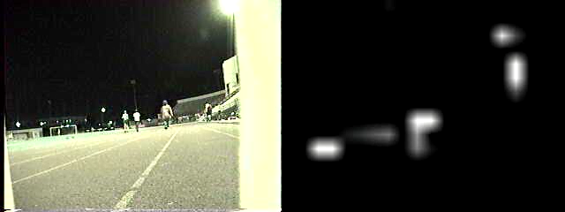
Using a look-up-table to encode f : P* → A
Example: Collision Avoidance
  Sensors: 3 proximity sensors
  Effectors: Steering Wheel, Brakes
How to generate?
How large?
How to select action?
obstacle
sensors
agent

Slide 27
Using a look-up-table to encode f : P* → A
obstacle
Example: Collision Avoidance
  Sensors: 3 proximity sensors
  Effectors: Steering Wheel, Brakes
How to generate: for each p ∈ P_{l} × P_{m} × P_{r}
generate an appropriate action, a ∈ S × B
How large: size of table = #possible percepts times # possible actions = |P_{l} | |P_{m}| |P_{r}| |S| |B|
E.g., P = {close, medium, far}³
A = {left, straight, right} × {on, off}
then size of table = 27*3*2 = 162
How to select action? Search.
sensors
agent

Slide 28
Agent types
Reflex agents
Reflex agents with internal states
Goal-based agents
Utility-based agents

Slide 29
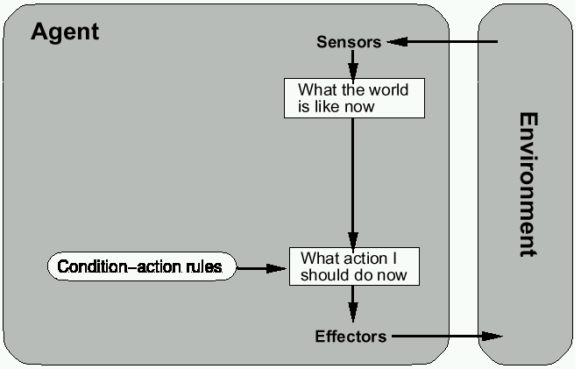
Reflex agents

Slide 30
Reactive agents
Reactive agents do not have internal symbolic models.
Act by stimulus-response to the current state of the environment.
Each reactive agent is simple and interacts with others in a basic way.
Complex patterns of behavior emerge from their interaction.
Benefits: robustness, fast response time
Challenges: scalability, how intelligent?
and how do you debug them?

Slide 31
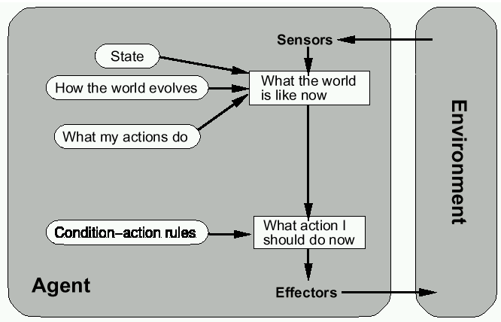
Reflex agents w/state

Slide 32
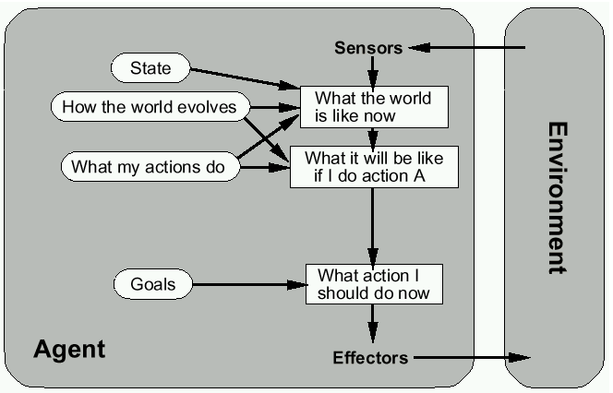
Goal-based agents

Slide 33
Mobile agents
Programs that can migrate from one machine to another.
Execute in a platform-independent execution environment.
Require agent execution environment (places).
Mobility not necessary or sufficient condition for agenthood.
Practical but non-functional advantages:
  Reduced communication cost (e.g., from PDA)
  Asynchronous computing (when you are not connected)
Two types:
  One-hop mobile agents (migrate to one other place)
  Multi-hop mobile agents (roam the network from place to place)
Applications:
  Distributed information retrieval.
  Telecommunication network routing.

Slide 34
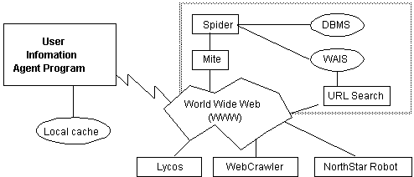
Information agents
Manage the explosive growth of information.
Manipulate or collate information from many distributed sources.
Information agents can be mobile or static.
Examples:
  BargainFinder comparison shops among Internet stores for CDs
  FIDO the Shopping Doggie (out of service)
  Internet Softbot infers which internet facilities (finger, ftp, gopher) to use and when from high-level search requests.
Challenge: ontologies for annotating Web pages (e.g., SHOE).

Slide 35
Summary
Intelligent Agents:
  Anything that can be viewed as perceiving its environment through sensors and acting upon that environment through its effectors to maximize progress towards its goals.
  PAGE (Percepts, Actions, Goals, Environment)
  Described as a Perception (sequence) to Action Mapping: f : P* → A
  Using look-up-table, closed form, etc.
Agent Types: Reflex, state-based, goal-based, utility-based
Rational Action: The action that maximizes the expected value of the performance measure given the percept sequence to date

